Slide 1
KISTI Grid CA Status Report
APGridPMA Meeting
Mar 8, 2010
Academia Sinica, Taipei, Taiwan
KISTI Supercomputing Center
Sangwan Kim (sangwan@kisti.re.kr)

Slide 2
KISTI Grid CA Statistics
Current Valid Certificates
User : 81
Host : 118
History of # of certificates issued per month

Slide 3
KISTI Grid CA Updates and Plans
Support research community
Geant4 user workshop (Feb 2010) about 30 participants from medical hospital, university, national cancer center
LIGO community (about 10 users)
Thus the users have little computer science or security background, they want easy method to get their certificates.
Plans
Upgrade the CA system
on-line subscription form
system management (strengthen backup and logging)
Vitalize RA's role
Documentation in Korean language
Client Software update for Windows 7 (now only support WinXP & IE)

Slide 4
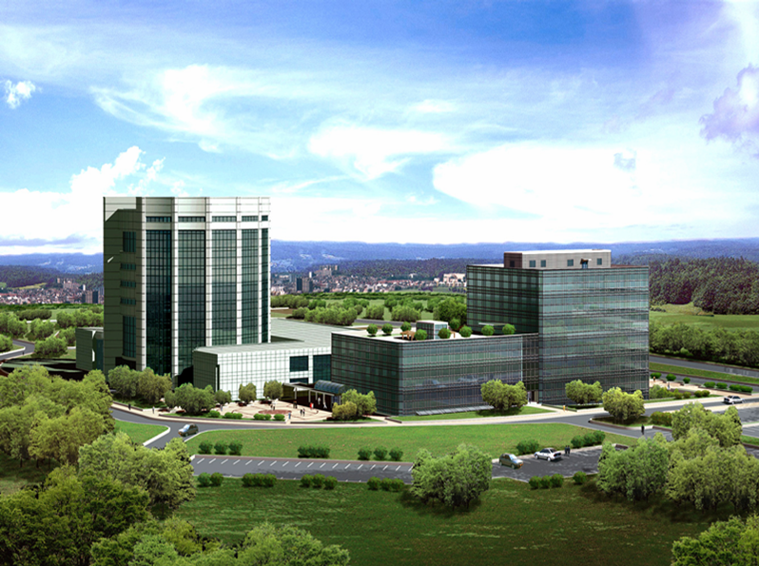
Thank You

