Slide 1
Updates from the
EUGridPMA
David Groep, Apr 20th, 2009

Slide 2
Updates from the EUGridPMA
Towards even more EMEA coverage
Authorization Operations WG
Novel CA architectures
  Federation-backed SLCS-MICS CAs
  Cross-national CAs
  Pending issues with the MICS profile
Auditing progress
Robots and 1SCPs
Credential Repositories

Slide 3
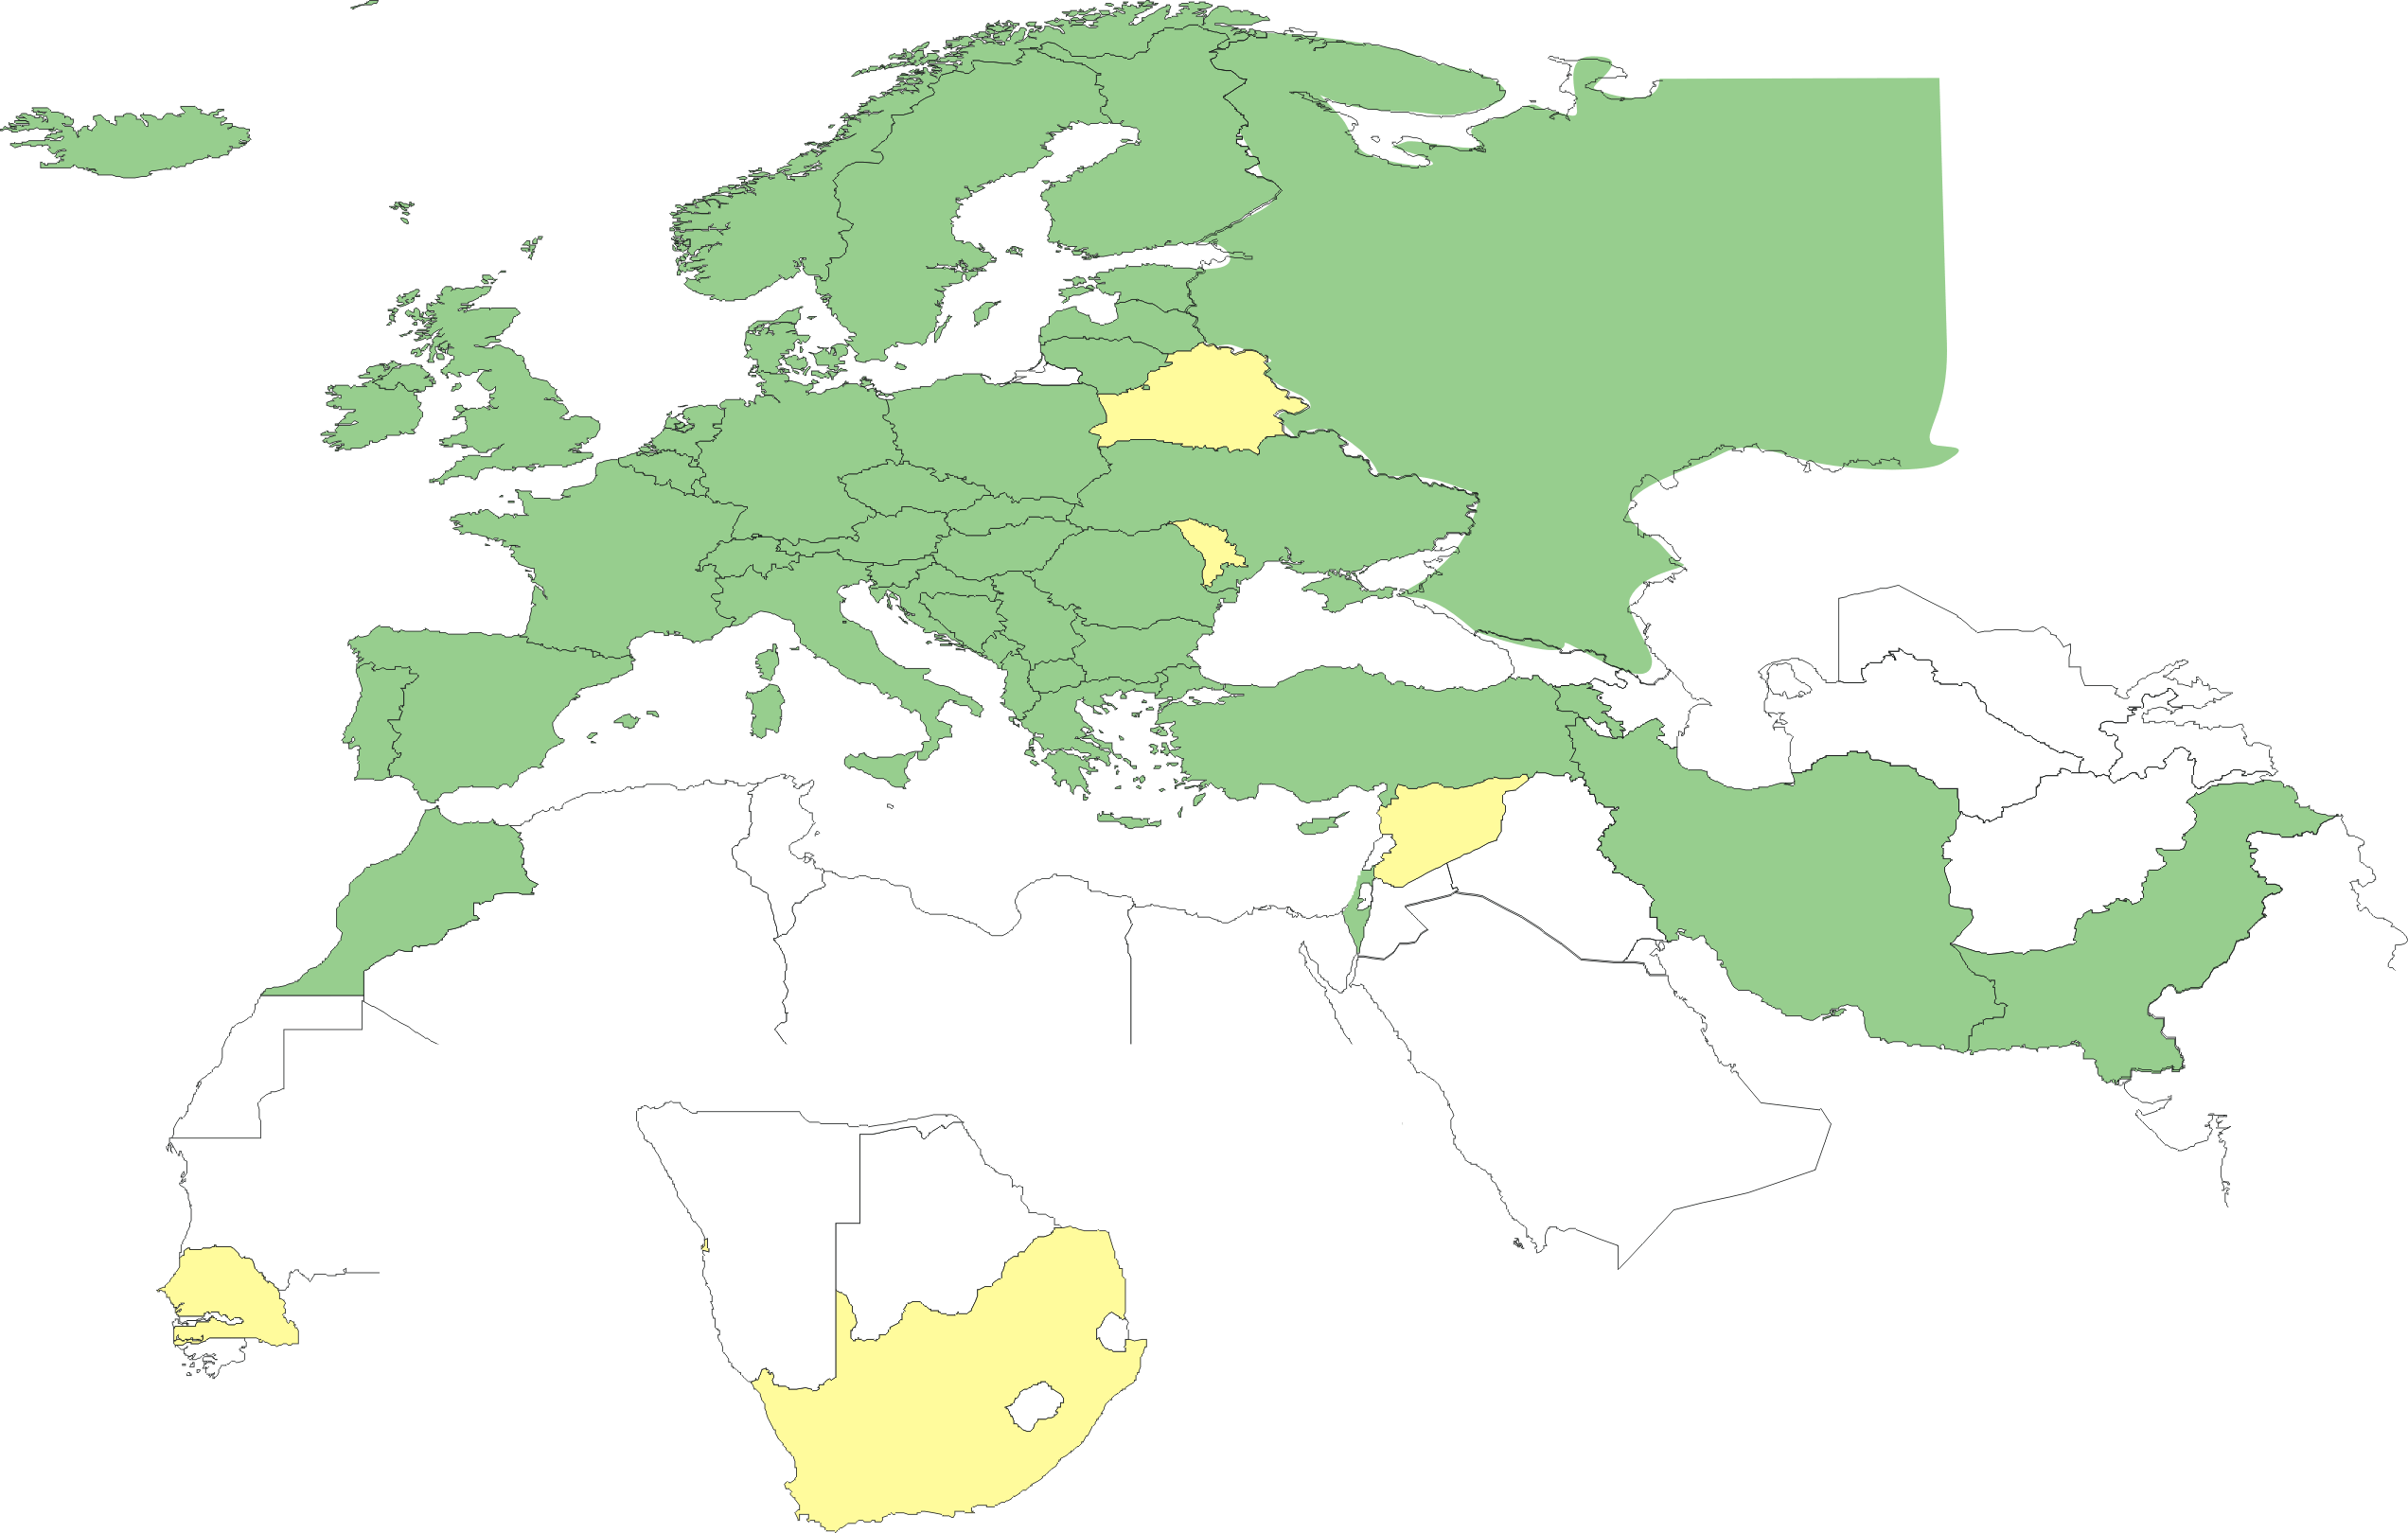
Geographical coverage of the EUGridPMA
23 of 25 EU member states (all except LU, MT)
+ AM, CH, HR, IL, IR, IS, MA, ME, MK, NO, PK, RO, RS, RU, TR,
UA, SEE-GRID + CA, CERN (int), DoEGrids(US)*
Pending or in progress
BY, MD, SY, LV, ZA, SN

Slide 4
‘AuthZ op. policy WG’
Extended meeting in December made quite some progress
See ‘Authorization Working Group report’ on EUGridPMA Nicosia agenda by Dave Kelsey

Slide 5
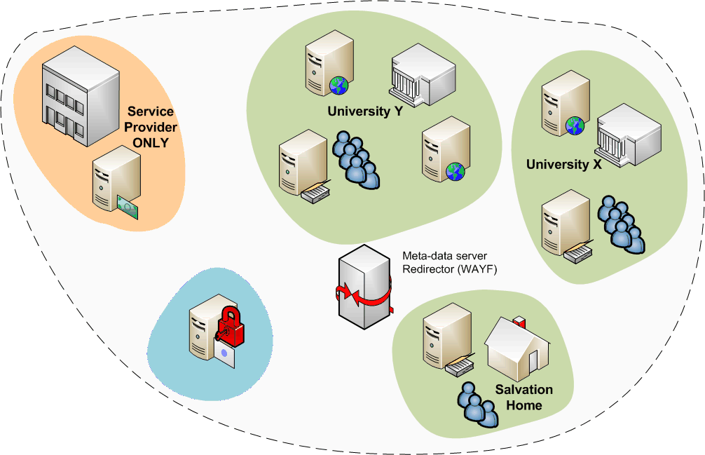
Federations
A common Authentication and Authorization Infrastructure
Allow access to common resources with a single credential

Slide 6
European Landscape
Identity Federations (or simply federations) are being developed at national level by the NRENs:
  Italy, Germany, Ireland, Czech Republic starting now
Different (open source) technologies are used
  Shibboleth: UK, Finland, Switzerland,Germany
  Most used technology, but not the only one!
  PAPI: Spain
  A-Select (Shib, PKI, ADFS, sSPHP,…): the Netherlands
  Sun Federation Manager based upon Liberty Alliance spec: Norway
Interoperation through use of SAML (2.0)

Slide 7
Grid & Federations - a logical combination
Many of the e-Infrastructure users
have a federated account anyway
  Could give users grid certificates within 5 minutes
  without any further hassle, if the trust level matches
  Allows users to ’try’ the grid
  Allows for scaling the number of grid users significantly
Comparable issues and trust levels
  Federation assurance levels are coming up,
  as more diverse services participate in the federation
  User account management of IdPs is improving rapidly
  … far more than grid credential management!

Slide 8
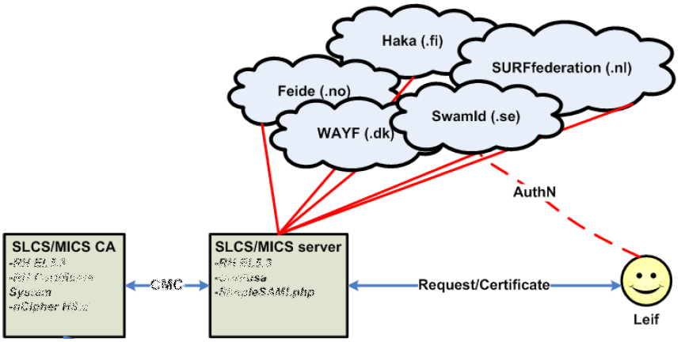
A Federated Grid CA
Use your federation ID
... to authenticate to a service
... that issues a certificate
... recognised by the Grid today
Graphic from:
Jan Meijer, UNINETT

Slide 9
Matching the ‘easy’ requirements
Persistent and unique naming
  IdPs historically tended to recycle login names
  even eduPersonPrincipalName is often recyled
  only eduPersonTargetedID is immune to thus,
  but not supported everywhere (and is usually opaque)
  this adds a requirement to the federation or to the IdPs
Reasonable representation of names
  Given name, surname and nickname are usually considered privacy sensitive
  user-approved release of these appears doable
  requires evaluation of legal framework

Slide 10
Matching the ‘harder’ requirements
How to protect against re-use of federation login and password (on e.g. Wiki’s, web sites, ISP mail)?
  The ‘second attribute’ is either privacy sensitive, or not standard across all IdPs, or difficult to collect
Handling revocation
  The CA is ‘just a service provider’, and the IdP does not know about the issued certs per se
  Even single sign-out is already difficult
Assurance level at the IdP
  The CA SP is usually the first ‘high-LoA’ application

Slide 11
Issues for discussion
MICS profile has ambiguous text in 4.4:
“The IdM manager must suspend or revoke authentication if member data changes or the traceability to the person is lost. Suspension or revocation must last until identity is updated and confirmed according to IdM policies.”
  What was meant? We hope:
“...must suspend or revoke the possibility of authentication to the IdM by the member if the member data ...”
Second authentication attribute?
  Introduced to protect again login data re-use elsewhere
  In worded as “MAY”
  Compensatory controls in place, e.g. password policy and use of credential to protect ‘valuable’ stuff
  – should be good enough

Slide 12
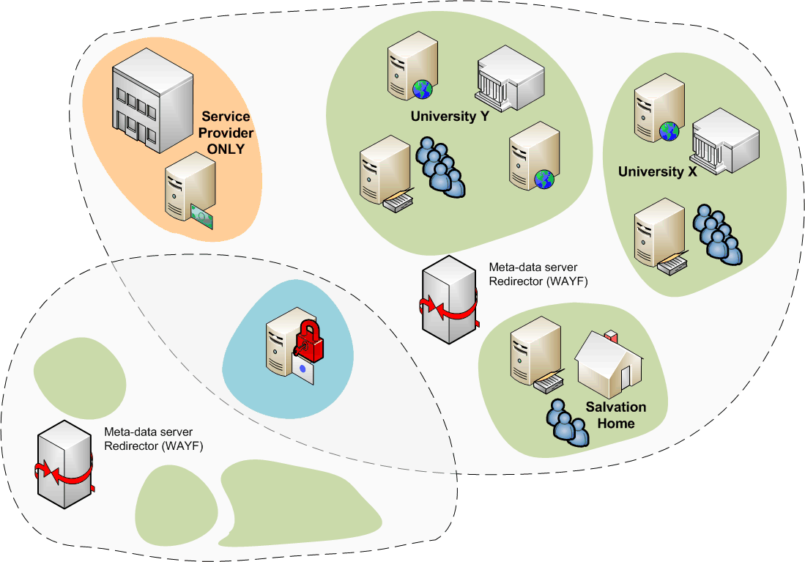
New: TERENA Grid CA Service
Initial partners:
FEIDE, SURFfederatie, HAKA, WAYF, Swamid, TERENA
(replaces DutchGrid and NorduGrid CAs)
Trans-national, cross-federation service
  But not (yet) confederated
How many SLCS/MICS CAs does Europe need ?
  Consolidate operational PKI skills in one place
  Better sustainability, in line with the European trend

Slide 13
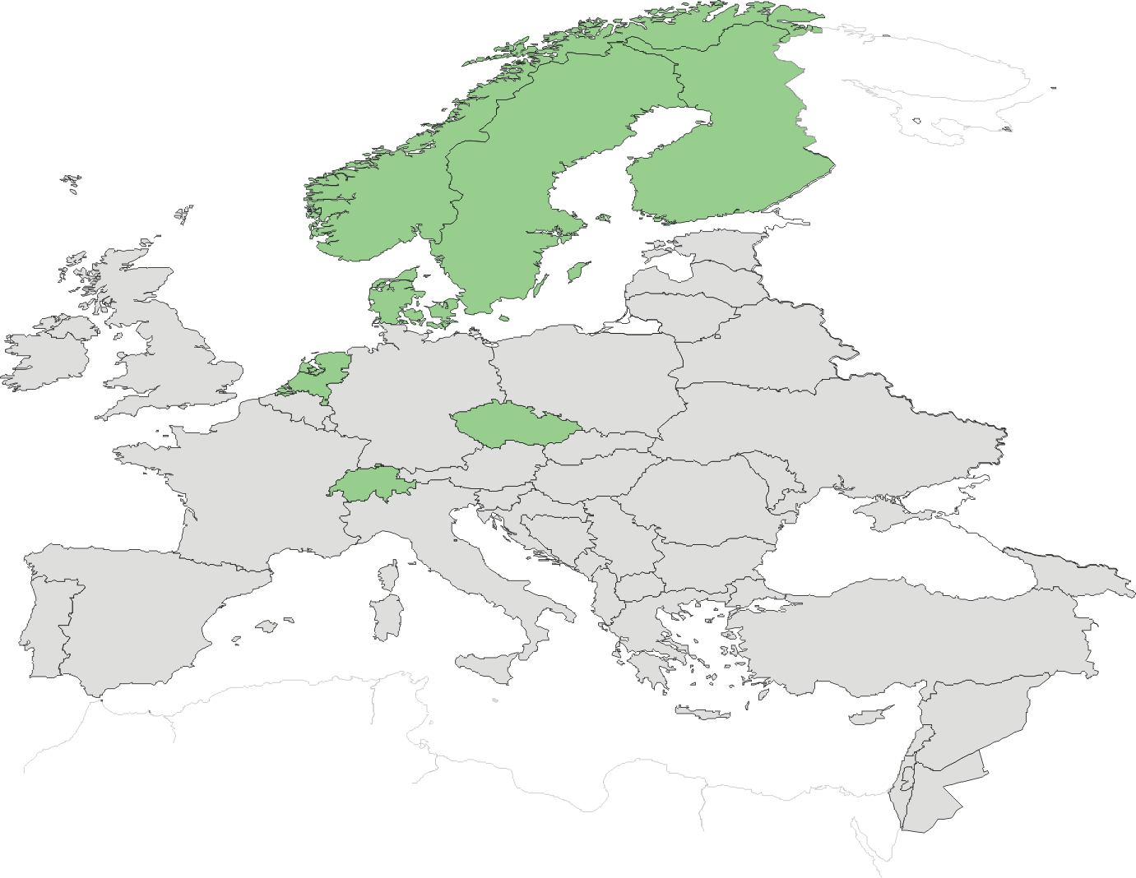
Federated CAs in Europe
SWITCH: May 2007
TERENA: May 2009?
CESNET: May 2009?

Slide 14
Auditing progress
Based on the Audit Guidelines by Yoshio
Require every 2-3 years for each CA:
  self-audit based on these guidelines
  present a summary to the PMA at large
  gets peer-reviewed in depth by assigned reviewers
Process is well under way
  3-5 presentations at each meeting
  Self-audits are typically quite self-critical and thorough
  Peer-reviewing of them is, however, not progressing as quickly as it should
  but recommendations are implemented regardless
Status and ‘age’ of audit is PMA-viewable ☺

Slide 15
Guidelines documents and policies
Robot certificate
  popularity of robot certs growing rapidly – action needed
  pre-requisite for portal policies in EGEE and many NGIs
  issued on a hardware token – cheap, safe and easy

Slide 16
Using OIDs for decision making
Add more OIDs to your end-entity certs
  At least the OID corresponding to the profile
  More OIDs from 1SCPs that match
And more 1SCPs OIDs are being assigned
  Already there:
  ‘private key is held on a token’
  ‘I was F2F identity-vetted’
  ‘I was vetter through a TTP’
  New:
  ‘I am a Robot/automated client’,
  ‘I an a server/host cert’

Slide 17
Credential Repositories
The ‘virtual smart card’ concept is back again!
Credential repository guidelines
  Risks, solutions, and the dissemination thereof is lacking
  Quick-scan of some MyProxy stores reveales ‘interesting’ things
  Guidelines may help – especially for ‘trusted’ credential stores operated by the NGIs (or other persistent infrastructures)
Discussed in Oct 2008, back on the agenda in Zurich
  Is it necessary to store long term credentials?
  If so, can a well operated repository be considered equivalent, or even better, than user held private keys? Like a ‘virtual smart card’
  If so, there should be strict policies and audits of such a repository!

Slide 18
IGTF Release Process and Web
Release Process
  Releases moved to (preferably) Monday or Tuesday
  More documentation of the process still needed
  More checks are now built into the process (Debian!)
  End use: https://dist.eugridpma.info/distribution
  https://www.apgridpma.org/distribution
  EUgridPMA site has off-site warm spare –
  which will be used in July-August during building change
Monitoring and alarms
  Nagios: http://signet-ca.ijs.si/nagios/ (guest/guest)
  Similar setup by Yoshio
  PMA Distribution Warnings by email 4 times/day
  It helps, but reaction to the warnings is down again …

Slide 19
Changes to the IGTF Charter
Proposal on namespace management
See special presentation …

Slide 20
Some dates for you to remember and schedule
11-13 May 2009: 16th, SWITCH, Zurich, CH
14-16 Sept 2009: 17th, DFN, Berlin, DE
18-20 Jan 2010: 18th, TCD, Dublin, IE
25-27 (or 17-19) May 2010: SigmaNet Riga, LV
September 2010: SRCE, Zagreb, HR
January 2011: RedIRIS, Madrid or Sevilla, ES

